Slide 1
NYU Tandon FRE 6883 Financial Computing Final Team 1 Project
Professor: Tang Song
Team leader: Yecheng Li
Members: Jingzhe Yu, Yuqing Wang, Mohan Liu
Semester: 2019 Fall Semester
Presentation Date: 05/14/2019

Slide 2
Task Allocation
Task | Allocation
Data/information collection (download from Bloomberg) | Mohan Liu
Group dividing (EPS in Excel) | Jingzhe Yu & Mohan Liu
Data retrieving and storage | Jingzhe Yu
Structure design and build | All team members
Calculation AAR and CAAR (Bootstrapping) | Yuqing Wang & Yecheng Li
Graph Visualization | Yuqing Wang & Yecheng Li
Menu design | Yecheng Li & Mohan Liu
Notes:
This slide shows the task allocation of our group.
Firstly, me and Jingzhe are responsible for data collection and group dividing.
After all team members discussing structure, then Jingzhe did data retrieve and storage.
Next, Yuqing and Yecheng built calculation function and graph visualization.
Finally, Yecheng and me finished the menu.

Slide 3
Content
Data/information collection (download from Bloomberg)
Group dividing (EPS in Excel)
Structure design and build
Data retrieving and storage
Implement of Bootstrapping
Menu design
Data visualization
Conclusion
Reference
Notes:
This is content for our project.

Slide 4
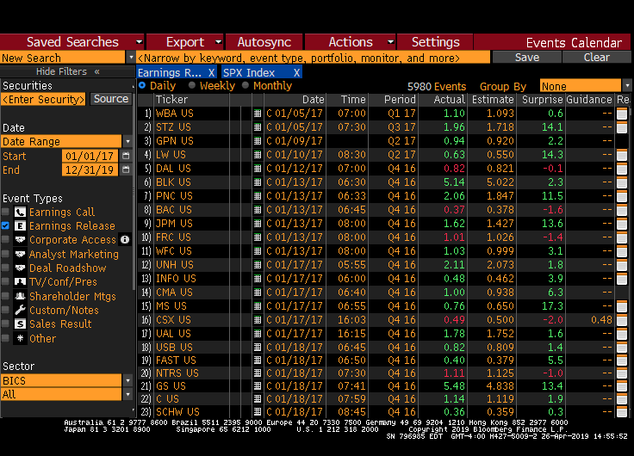
1. Data/information collection (download from Bloomberg)
Download SP 500 data from Bloomberg
Retrieve information includes:
Ticker
EPS Releasing Date
Period
Actual EPS
Estimate EPS
Surprise
Notes:
Open the Bloomberg terminal, search for EPS and SPX Index information, and select the range of days.
We are able to get stock’s name, EPS releasing date, second quarter 2018, actual and estimate EPS, and surprise.

Slide 5
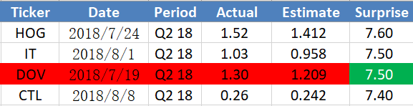
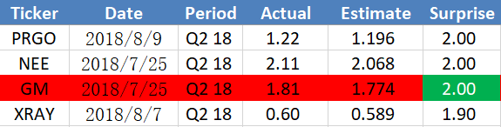
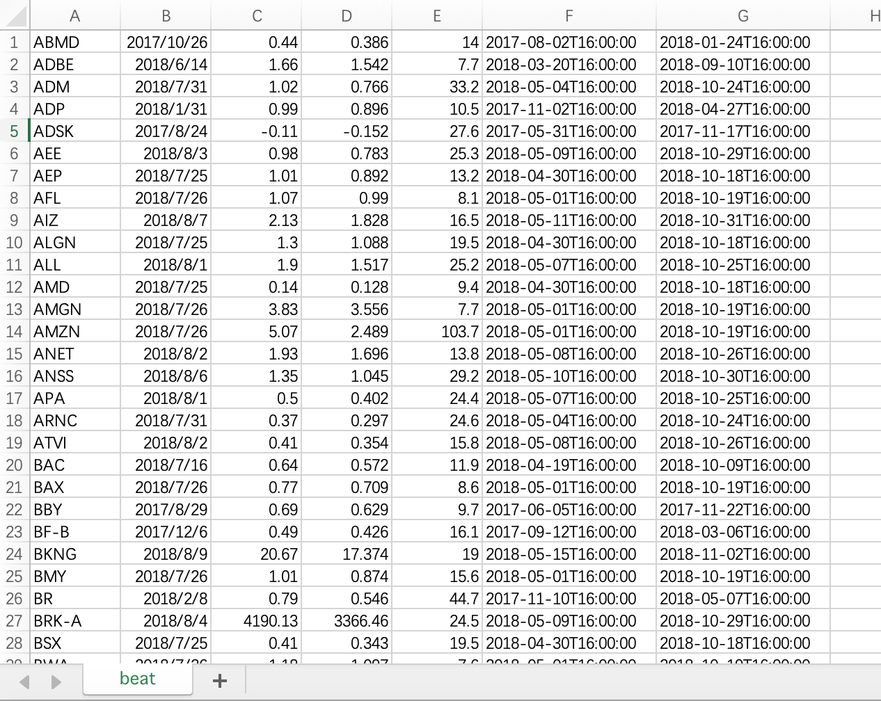
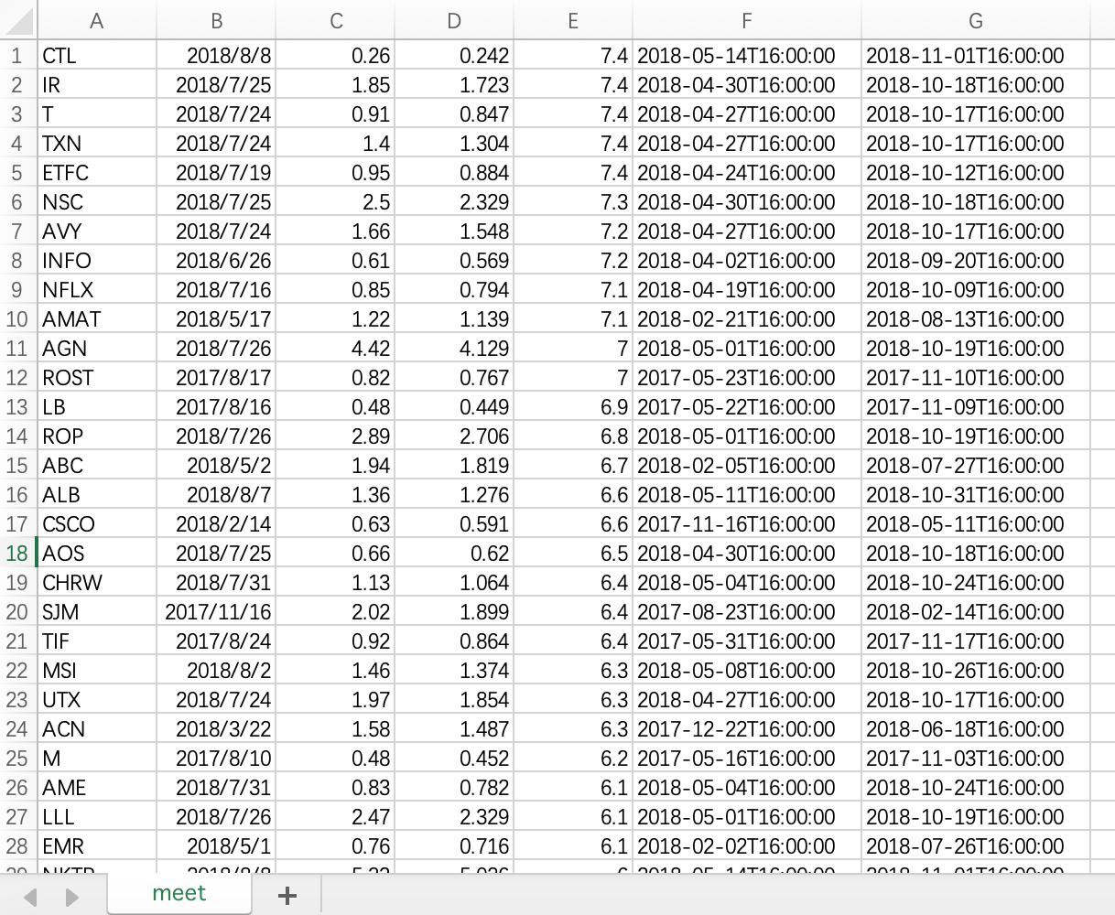
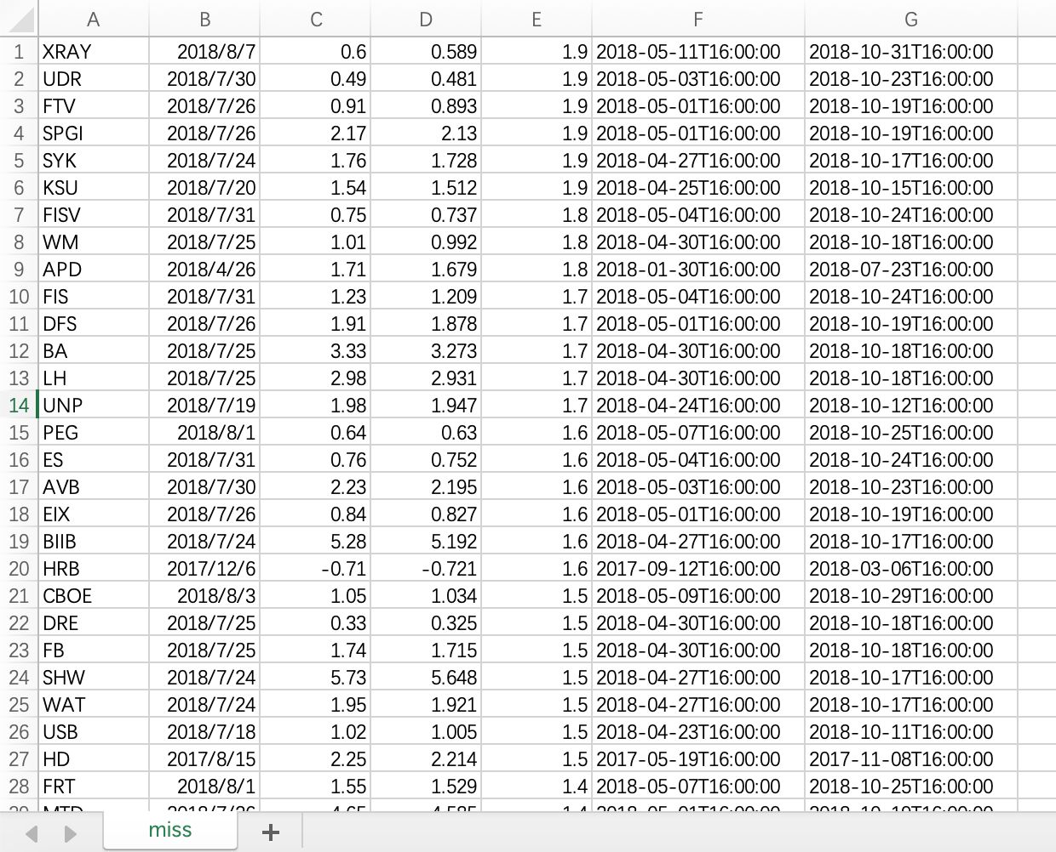
2.Group dividing
Thresholds are 7.5% and 2%
Divided all stock into three groups:
Beat group: Total 155 stocks; Surprise is above 7.5%.
Meat group: Total 158 stocks; Surprise is between 2% and 7.5%.
Miss group: Total 169 stocks; Surprise is below 2%.
Notes:
Order the surprise from the top to bottom.
Process data in Excel and transfer date format to “year-month-day-T-time”.
Divide into three groups and determine the thresholds, which is 7.5% and 2%.

Slide 6
3.Structure design and flow diagram
Notes:
Retrieved data from csv files and Yahoo Finance, stored them in several STL data structures
Designed two main classes: Stock and Map
Used Stock to store EPS-related information and 121-day price, calculate abnormal return
Used Group to do bootstrap sampling, calculated average AAR and CAAR
Stored AAR & CAAR in a matrix, designed a plot function to visualize them

Slide 7
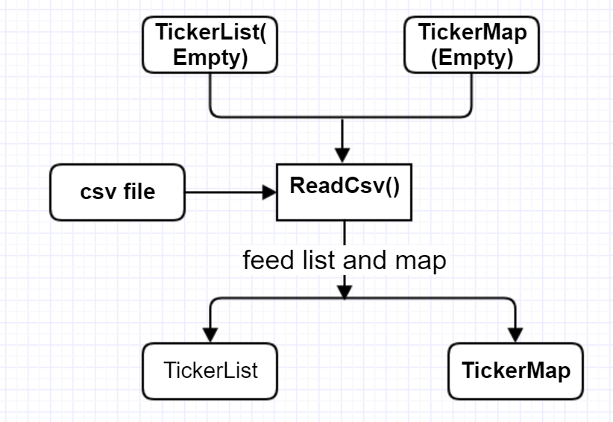
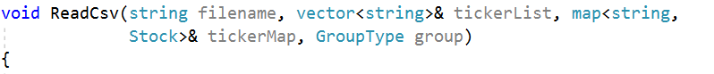
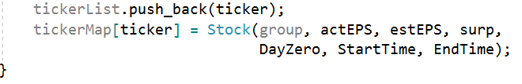
4.Data retrieving and storage
Load EPS-related data from csv and store them in Stock objects:
Four parameters: csv file name, a empty vector to store tickers, a map to create Stock objects for corresponding tickers, an enum
...
...
Notes:
Designed a function to read data from csv files
Pass into two empty data structures
Retrieved data from files and feed them into TickerList and TickerMap
Called a constructor for Stock class to create a new pair for the map

Slide 8
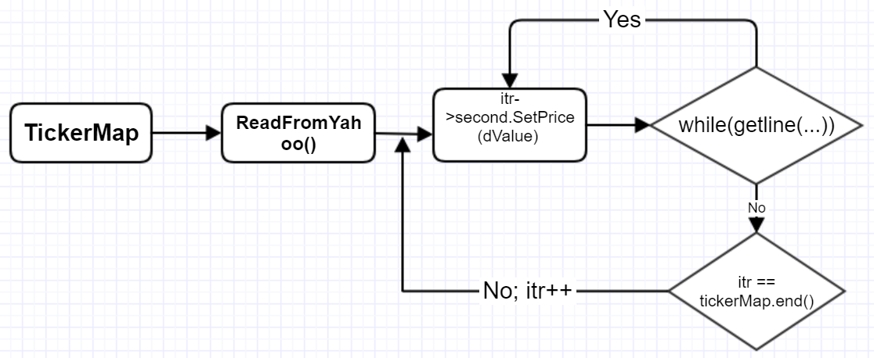
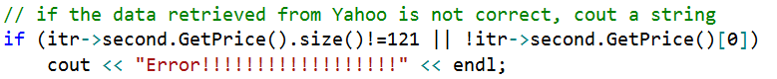
4.Data retrieving and storage (Cont.)
Download price data for all the stocks from Yahoo Finance and store them in the data member of stock objects
Download prices for SPY during 2017-2018
Notes:
Modified codes provided by our professor and encapsulated them into two functions
Pass into a map and traverse it
For each stock, run a while loop to push a price into the price list day by day
Wrote a if clause to examine whether the data for a stock are complete or not

Slide 9
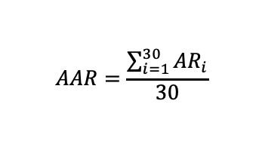
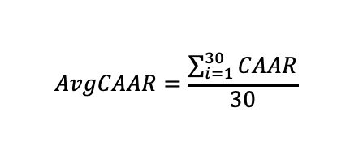
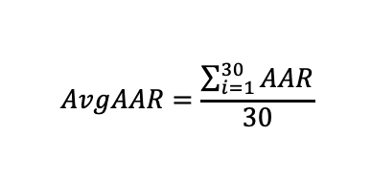
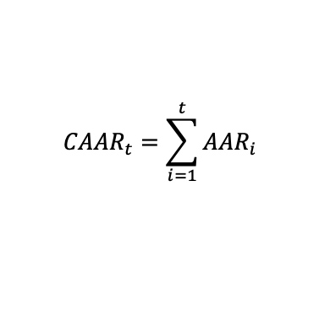
5. Bootstrapping Implementation
$$AAR=\frac{\sum_{i=1}^{30}{{AR}_{i}}}{30}$$
$${CAAR}_{t}=\sum_{i=1}^{t}{{AAR}_{i}}$$
$$AvgAAR=\frac{\sum_{i=1}^{30}{AAR}}{30}$$
$$AvgCAAR=\frac{\sum_{i=1}^{30}{CAAR}}{30}$$

Slide 10
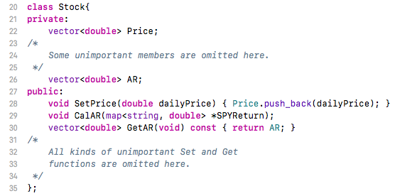
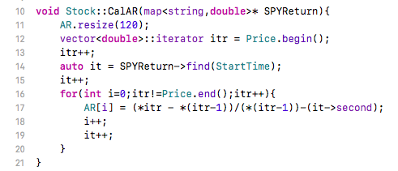
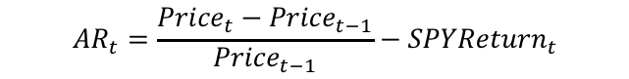
5. Bootstrapping implementation (Cont.)
$${AR}_{t}=\frac{{Price}_{t}−{Price}_{t−1}}{{Price}_{t−1}}−{SPYReturn}_{t}$$

Slide 11
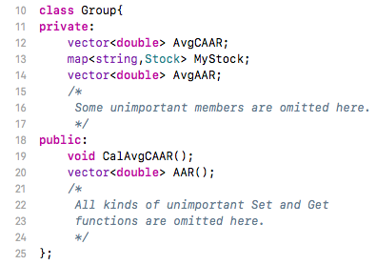
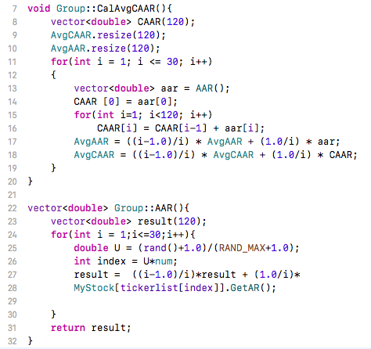
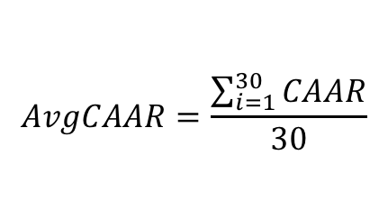
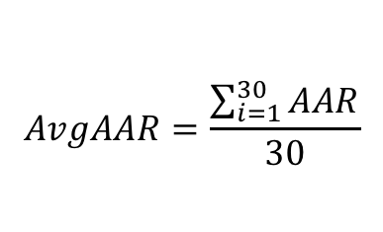
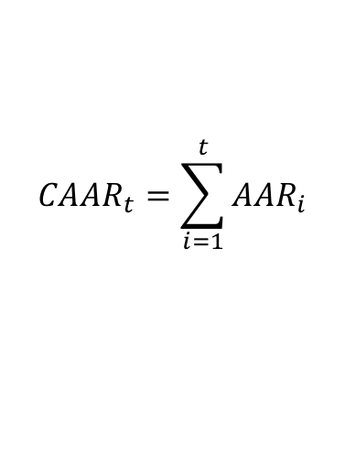
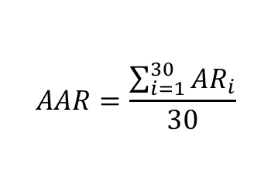
5. Bootstrapping Implementation(Cont.)
$${CAAR}_{t}=\sum_{i=1}^{t}{{AAR}_{i}}$$
$$AvgAAR=\frac{\sum_{i=1}^{30}{AAR}}{30}$$
$$AvgCAAR=\frac{\sum_{i=1}^{30}{CAAR}}{30}$$
$$AAR=\frac{\sum_{i=1}^{30}{{AR}_{i}}}{30}$$

Slide 12
6.Menu design
Retrieve historical price data for all stocks. i. Utilized libcurl to populate stocks’ maps.
2) Pull information for one stock from one group.
i. Use ticker to locate specific stock along with its information
3) Show AAR or CAAR for one Group.
i. Display the data vector of selected group and data type.
4) Show the graph with CAAR for all 3 groups
i. Utilized gunplot to graph our CAAR for all 3 groups.
5) Exit your program.
Notes:
Here are listed 5 options that we would love to implement in our main functions

Slide 13
Before we move to options...
int Option = 0;
do
{
cout <<
“Menu instruction…”
<< endl;
cout << "Enter your option: "; cin >> Option;
}
while(Option >= 0 && Option <5);
vector<string> BeatList, MeetList, MissList;
map<string, Stock> BeatMap, MeetMap, MissMap;
map<string, double> SPY;
map<string, double>* SPYptr = nullptr;
Group* BeatPtr = nullptr;
Group* MeetPtr = nullptr;
Group* MissPtr = nullptr;
Matrix DataMatirx;
VectorV BeatVector(2);
VectorV MeetVector(2);
VectorV MissVector(2);
Notes:
Before we move to the details of our menu, we did a few things up ahead. Instead of letting the retrieving data process run by default, we created several empty lists, maps, vectors and matrix and we can updates when we execute different options. And we use do…while structure so that we can go back to our main menu after each option execution.

Slide 14
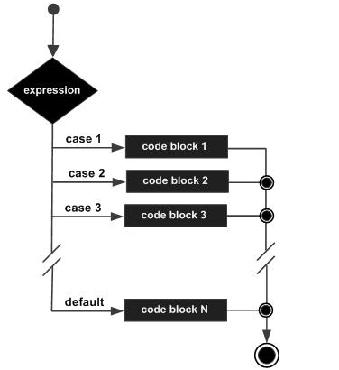
Before we move to options...
switch(Option)
{
case 1:{ //retrieve data
break;}
case 2:{ //Pull information
break;}
case 3:{ // AAR or CAAR
break;}
case 4:{ // Graph
break;}
case 5:{ //Exit program
break;}
default:{ cout << “Invalid input” << endl;
Option = 0;
break;
}
Notes:
We created an integer called Option and use switch functions to decide which number the client entered. We have case 1-5 and a default case the indicate the invalid input

Slide 15
2) Pull stock information
// Check if data is retrieved from Yahoo & Use input stock ticker to pull stock information
Make sure doing Option 1 firstly
Locate the Tickername from which group
Use Display() function to show stock's information
Continue or go back menu
Reselect stock information if not in the S&P 500

Slide 16
3) Display AAR or CAAR
// Run Bootstrapping for 30 times and display the selected data
Group* GroupCalculation(vector<string>& TickerList, map<string, Stock>& Mystock, map<string, double>* SPYptr)
{
for (map<string, Stock>::iterator itr = Mystock.begin(); itr != Mystock.end(); itr++)
{itr->second.CalAR(SPYptr);}
Group* GroupPtr = new Group(TickerList, Mystock);
GroupPtr->CalAvgCAAR();
return GroupPtr;
}
Case 3:{BeatPtr = GroupCalculation(BeatList, BeatMap, SPYptr);
MeetPtr = GroupCalculation(MeetList, MeetMap, SPYptr);
MissPtr = GroupCalculation(MissList, MissMap, SPYptr);}
Notes:
This is an independent function that we wrote right before the main function. We use this function to implement our bootstrapping process and then store the AvgAAR and AvgCAAR after each sampling process

Slide 17
3) Display AAR or CAAR (Cont.)
typedef vector <double> VectorD;
typedef vector <VectorD> VectorV;
typedef vector <VectorV> Matrix;
 | Vector for (Avg)AAR | Vector for (Avg)CAAR
Beat | Vector<double> Beat (Avg) AAR (120) | Vector<double> Beat (Avg) CAAR (120)
Meet | Vector<double> Meet (Avg) AAR (120) | Vector<double> Meet (Avg) CAAR (120)
Miss | Vector<double> Miss (Avg) AAR (120) | Vector<double> Miss (Avg) CAAR (120)

Slide 18
7. Data visualization

Slide 19
8.Conclusion
After EPS release, the Abnormal Returns for Beat group will tend to go up to 2% and Miss group will go down to -3.5%.
The price change generated by bad news (i.e. estimate EPS > actual EPS) has greater magnitude than that generated by good news(i.e. estimate EPS < actual EPS)
Short after the releasing dates, both Beat and Meet group will have positive Abnormal Returns.
In long term, Miss group will continuously go down as negative effects of bad news, which may create panic and sell off

Slide 20
9. References
Bloomberg Terminal
”gunplot_ex1” and “libcurl.zip”, Tang Song
“Read CSV files using C++”, http://www.runoob.com/cplusplus/cpp-do-while-loop.html
C++ Tutorial: http://www.runoob.com/cplusplus/cpp-do-while-loop.html

